Slide 1
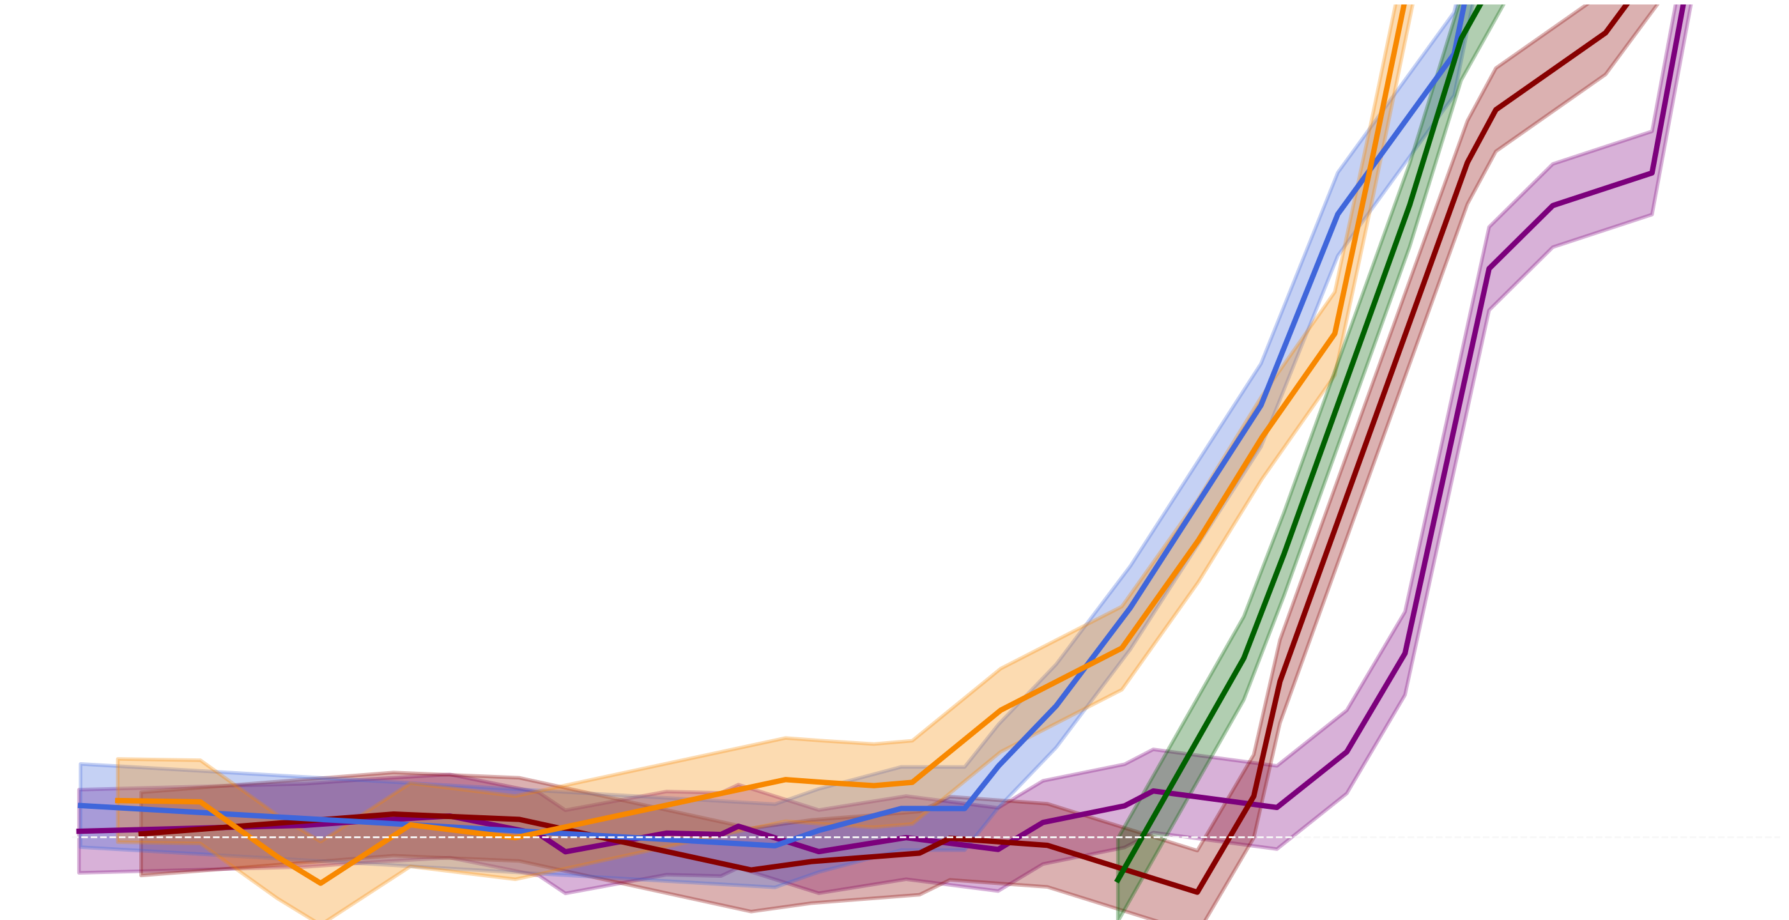
Using Deep Learning for
Jet Tagging
Project 2 “extra”

Slide 2
Problem Setting: Bump Hunt
Task: Bump Hunt
in mass spectrum
Higgs

Slide 3
Problem Setting: Bump Hunt - Vast Amounts of Background
Coming up with good observables that discriminate signal and background isn’t easy:
Leverage the power ML to “clean up” the data

Slide 4
Problem Setting: Bump Hunt - Using ML
“High-level” jet properties
Machine Learning
Algorithm
Jet Shape
Energy Correlations
N-subjetiness
Discriminator

Slide 5
Problem Setting: Bump Hunt - Using ML
“Low-level” particle information
Machine Learning
Algorithm
Four-momenta
Global information
Discriminator

Slide 6
Problem Setting: Bump Hunt - Using ML
Offloads figuring out good discriminators ($τ_{21}$ for example) onto the “machine.”
ML classifiers can be biased (more so than other techniques):
Need a way to mitigate this bias

Slide 7
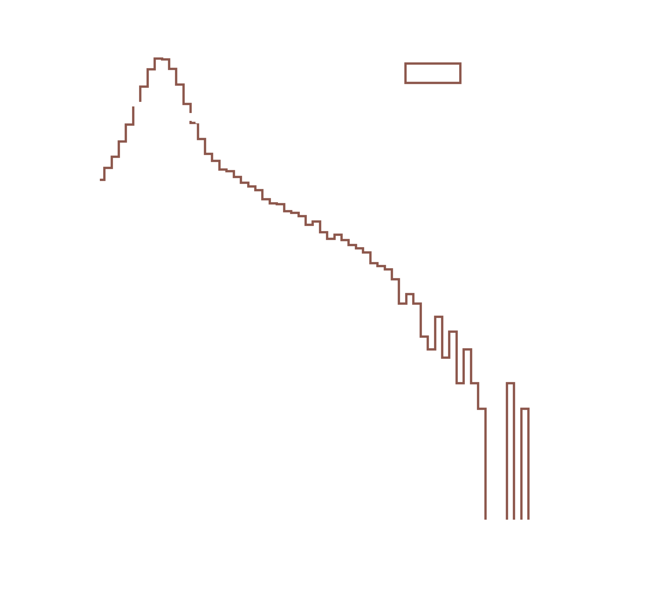

The Naive Classifier (can be “too” good)
What happened here?
The classifier learned to use mass as a discriminator
The classifier can learn the mass of the signal even when not trained explicitly on it

Slide 8


Problem statement

Slide 9
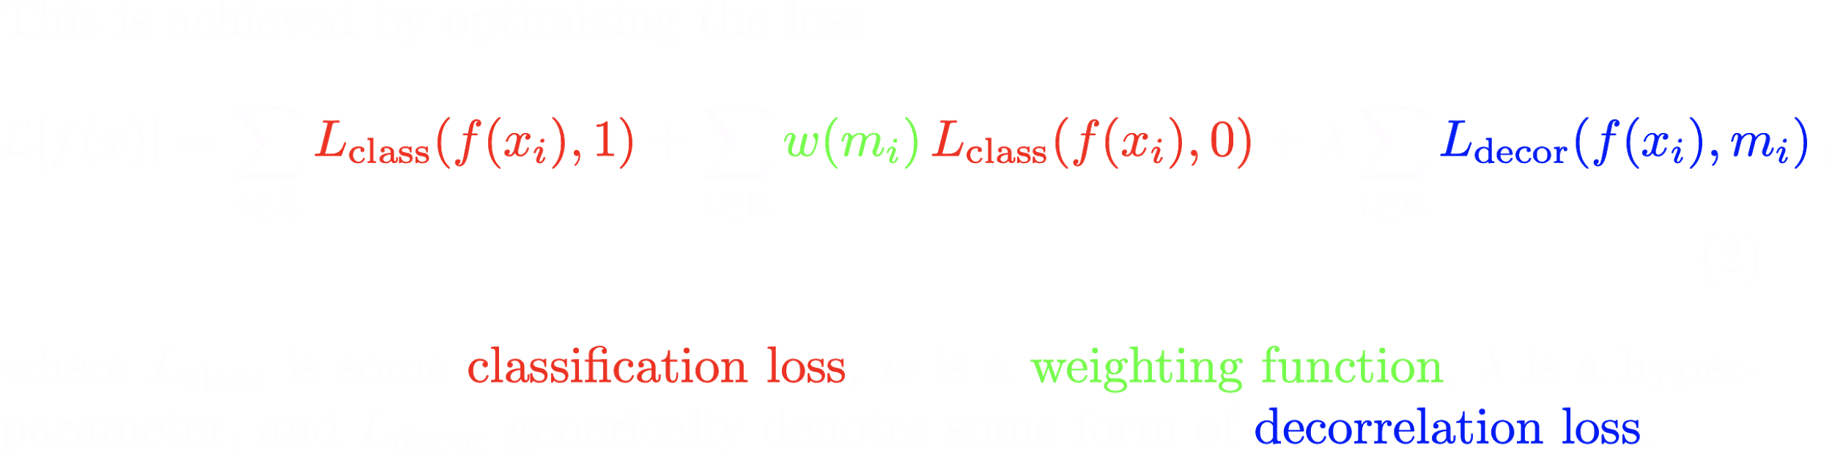
Problem statement

Slide 10
Methods
Analytical methods: Remove mass dependence from substructure observables.
Designed Decorrelated Taggers: Assume linear relationship between tagger and resonant feature. Use new observable with subtracted dependence.
k-NN: More General regression fit of observable as a function of resonant feature. Remove any dependence and use decorrelated observable.
Planing:
Reweighting events to be uniform in mass.
MVA-based:
uBoost
KL divergence
DisCo
Adversarial
MoDe

Slide 11
Methods
Analytical methods: Remove mass dependence from substructure observables.
Designed Decorrelated Taggers: Assume linear relationship between tagger and resonant feature. Use new observable with subtracted dependence.
k-NN: More General regression fit of observable as a function of resonant feature. Remove any dependence and use decorrelated observable.
Planing:
Reweighting events to be uniform in mass.
MVA-based:
uBoost
KL divergence
DisCo
Adversarial
MoDe

Slide 12
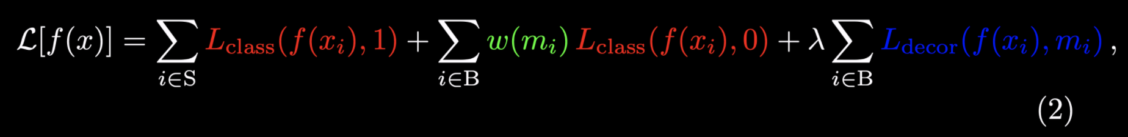
Planing
We choose $w(m_{i})≈p_{S}(m)/p_{B}(m)$ so that the marginal distribution of $m$ is non-discriminatory after the reweighting.
Ensures that background events close to signal peak are given more importance in classification.
Simple commonly used reweighting technique.
Doesn’t necessarily guarantee independence.

Slide 13

Kullback-Leibler Divergence
KL divergence: $D_{KL}(P||Q)=\underset{x∈X}{∑}P(x)log\frac{P(x)}{Q(x)}$
Measure the degree of similarity between two distributions.
One way to implement it is to measure the similarity between the original mass spectrum ($P(m)$) of the background and the mass spectrum of the selected background ($Q(m)$) and penalize any differences.

Slide 14
DisCo (Distance Correlation)
Pearson’s Correlation : 𝜌 = cov(S,M)/(𝜎_{S}𝜎_{M})
Only measures linear correlation: Independence → 𝜌 = 0 but the converse isn’t necessarily true.
Distance Correlation : dCor(S,M) = dCov(M,S)/(d𝜎_{M}d𝜎_{S})
where dCov²(M,S)= cov(||M-M’||,||S-S’||) - 2cov(||M-M’||,||S-S’’||)
And d𝜎_{M} = dCov(M,M)
Sensitive to all correlations: Independence iff dCor = 0.

Slide 15
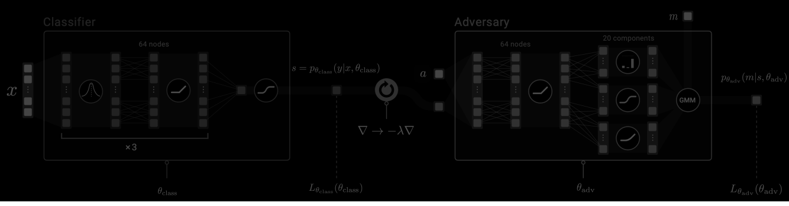
Adversarial Decorrelation
The classifier is now trained against an adversary.
Specifically the adversary we will use is a Gaussian Mixture Network that parametrizes a Gaussian mixture model with 20 components, i.e. its outputs are the means, variances, and mixing coefficients of 20 normal distributions.

Slide 16

Adversarial Decorrelation - Non-Convex Problem
Difficult problem. Complicated to train! Adds a whole NN’s worth of parameters to train and hyperparameters to tune.
Very powerful when you get it to work.

Slide 17
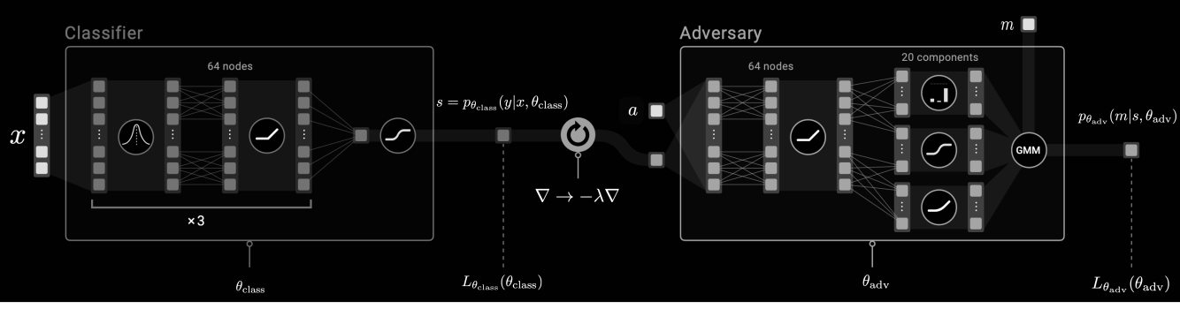
Adversarial Decorrelation
Adapted from “ATLAS Collaboration, Performance of mass-decorrelated jet substructure observables for hadronic two-body decay tagging in ATLAS, Tech. Rep.ATL-PHSS-PUB-2018-014, CERN, Geneva, Jul, 2018.”

Slide 18
MoDe[0] - Decorrelation
MoDe[0] achieves decorrelation by penalizing any dependence of the CDF of the classifier output ($s$) on the protected attribute ($m$).
By adding the following loss:
$L_{decor}=L_{MoDe}^{0}$
Where
$L_{MoDe}^{0}≡\underset{m}{∑}∫|F_{m}(s)-F_{m}^{0}(s)|^{2}ds,$
And $F_{m}^{0}(s)=c_{0}(s)$ is the 0th order Legendre Moment of $F_{m}(s)$.
Notes:
There really should be a third axis that measures the amount of time you spend or anger you feel implementing each of these methods. Adversarial training would probably be many orders of magnitude higher than other methods...

Slide 19
Flattening the peak by tweaking $λ$ in $L_{class}+λL_{MoDe}^{0}$

Slide 20
Can we do better?
Yes! Independence is a strong constraint.
We can allow some controlled dependance.

Slide 21
MoDe[l] - Beyond Decorrelation
How can we allow for some dependence without sculpting peaks?
$L_{MoDe}^{l}≡\underset{m}{∑}∫|F_{m}(s)-F_{m}^{l}(s)|^{2}ds$
Here, $F_{m}^{0}$ has been replaced by
$F_{m}^{l}(s)=\overset{l}{\underset{i=0}{∑}}c_{i}(s)P_{i}(\overset{˜}{m})$
Allow for Legendre moments of orders up to l and penalize higher orders.

Slide 22
Flattening the peak (to first order)

Slide 23
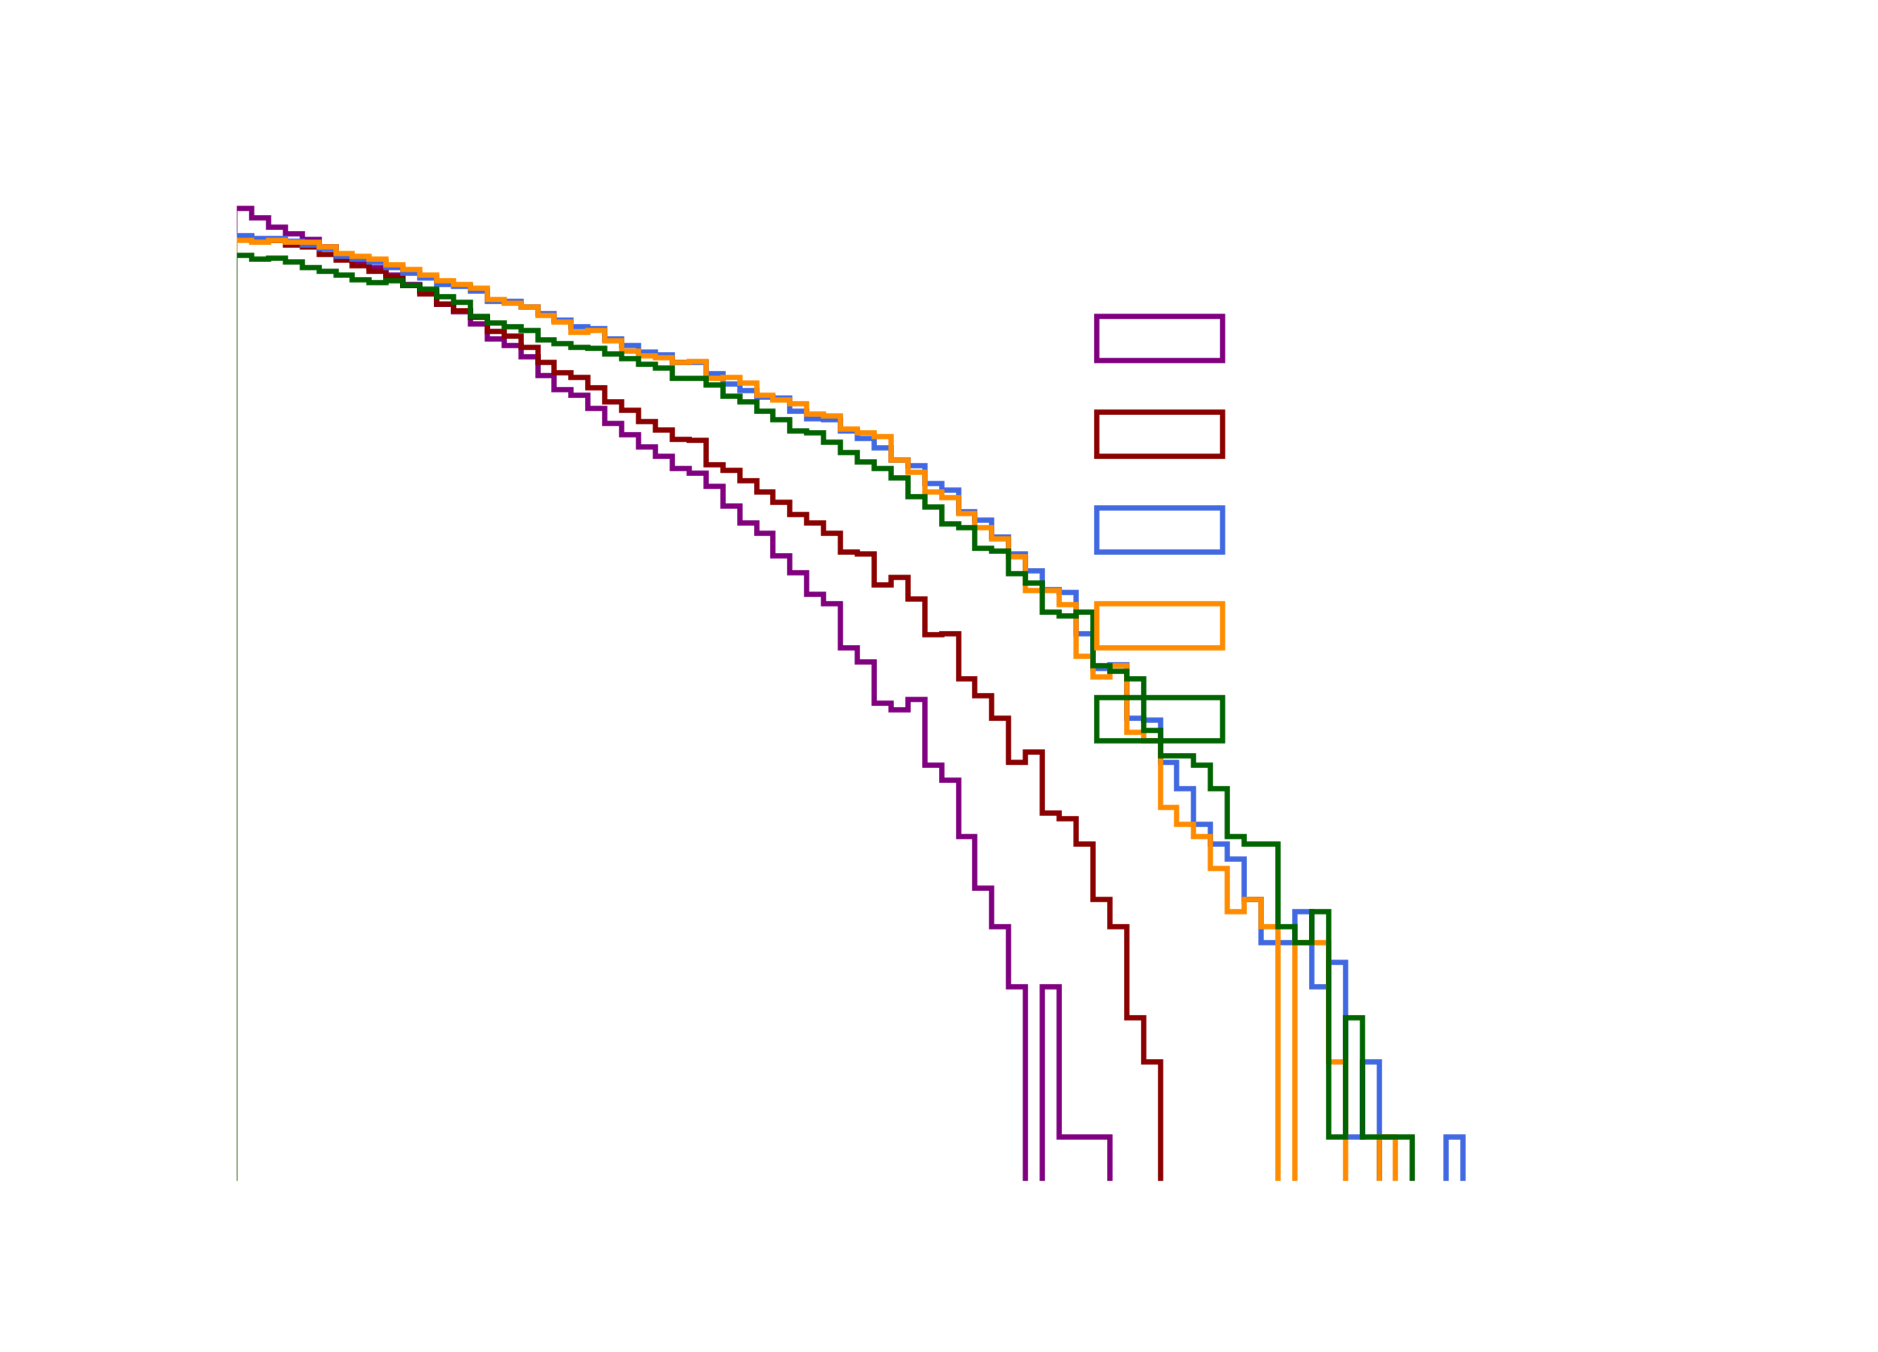
MoDe[l] vs. Other Methods

Slide 24
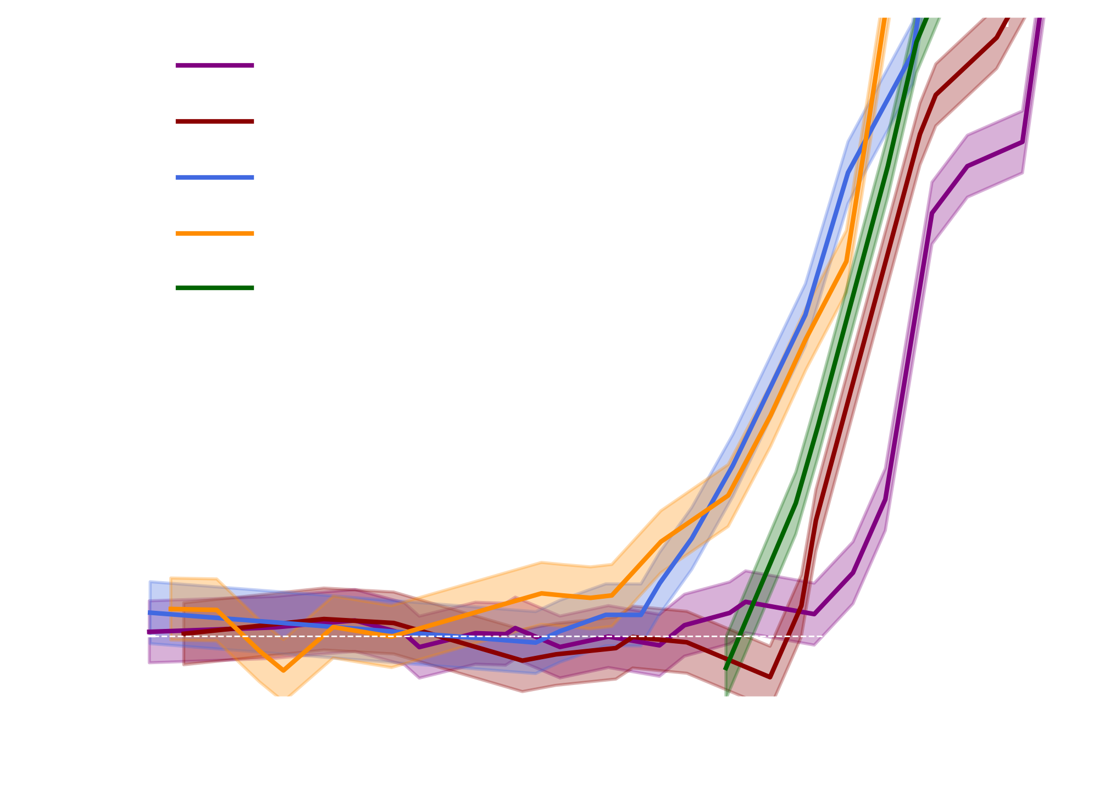
Bias and Rejection Power
The flexibility beyond simple decorrelation provided by MoDe[1,2] results in improved performance i.e. our new classifiers have better rejection power (~20% increase) and introduce no signal bias.
$$≳20\%$$
better
Improvement

Slide 25
Unconstrained
Classifier
Regularized Classifier
(Decorrelation)
MoDe
Powerful
Unbiased
Notes:
There really should be a third axis that measures the amount of time you spend or anger you feel implementing each of these methods. Adversarial training would probably be many orders of magnitude higher than other methods...

Slide 26
Questions?

